Slide 1
Introductory Level PGR Rep Training
name of trainer
associate trainer | GUSRC

Slide 2
Learning outcomes for today
Develop your understanding of the PGR rep role
Develop your understanding of the mechanisms for student representation here at the University of Glasgow
Discuss the research student experience and explore how you can use it to improve your fellow students’ collective experience.
Develop some of the skills you will use as PGR rep.

Slide 3
Kate Powell, Vice-President (Education)
Link to video

Slide 4
Exercise 1 Your area of research
Task
In pairs, discuss the following questions:
What is your area of research?
What do you like most about the research environment in your School or Research Institute?
How might the research environment be improved?

Slide 5
Exercise 2 Your representative role
Task
What is your purpose in being a student rep?
What do you think some of the tasks will be?
What skills do you think you will need (and develop) as a rep?
How do you think being a rep will benefit you?

Slide 6
The representative role
Purpose
To continuously improve the student learning and research experience in partnership with the institution and SRC by helping create solutions to problems.
To represent your fellow students’ views and opinions on all matters relating to learning and teaching/supervision and the research environment.
To provide both positive and negative feedback to staff.
To act as a communication channel between staff and students.
What does the University expect?
Legitimate representation (don’t just pursue your own agenda)
Negotiation not confrontation
Feedback (let the University and GUSRC know what you’ve thought about being a rep)

Slide 7
The representative role
Tasks
Introduce yourself to the students you are representing.
Gather student opinion.
Provide feedback to staff and students.
Read documentation (minutes etc) prior to meetings
Present student views at meetings.
Attend meetings.
Speak to people outside of meetings.
Develop solutions to issues.
Pass issues onto GUSRC via GUSRC PG Convenors or College Convenors.
Contribute to institutional activities.

Slide 8
The representative role
Skills used (with Vitae Researcher Development Framework* areas)
Communication (D2)
Networking/Relationship Building (B3, D1)
Reflection/Analysing/Problem Solving (A2)
Presentation/Reporting (D2)
Diplomacy/Negotiation/Influencing (D1)
Research (A2)
Time management/prioritisation/organisation (B2)
*see page 5 of the training handbook

Slide 9
The representative role
Benefits to you
Researcher Development – experience and skills development, useful for future employment.
Wider knowledge of institution and current issues in higher education.
Make a difference to the PGR student experience.
Networking opportunities.
Looks good on your CV.
Background for future representational roles.
Can be validated on your student transcript.

Slide 10
Why is representation important?
Student views
Dialogue with staff
Improved learning/ research experience
YOU ARE THE EXPERT!

Slide 11
Developments in student representation at Glasgow
Training and handbook specifically tailored for PGR reps
Student Voice website – discussion forum, feedback and contact details for reps. Tailored to your study choices. Easier to connect with and build your community.
The Gilchrist Postgraduate Club – your own social & learning space to help you connect with other PGR students.
University now looking at how it maintains oversight of the PG student experience
GUSRC working on improved PG representation and engagement

Slide 12
Recognition on your transcript
The University will recognise and record on the transcript periods undertaken as a student representative:
“Subject to confirmation of training being completed
and confirmation from the relevant School that
term of office as a PGR Representative
has been completed”.
Attend the training – make sure you sign the attendance sheet
Complete your duties – make sure you go to meetings or let people know if you can’t make it
You will also be asked to complete a short questionnaire, towards the end of the academic year, reflecting on challenges and achievements during your time as rep.
Notes:
The quote highlighted above is from the Code of Practice on Student representation which everyone should familiarise themselves with and is downloadable fro the University website
It is important to note that simply coming to this training session does not qualify you to any recognition on your transcript. The training is only one of the components . The other component requires thet you have completed you term of office as a Student Representative to the satisfaction of your School (or the College Office if you are a Rep on a College committee). It is therefore important that you attend all relevant meetings or arrange for a substitute if necessary. AS previously stated you should also ensure you are fully prepared for the meetings. If there is something in the committee papers you don’t understand please contact your College Representative or The VP Learning and development, Morven Boyd.

Slide 13
The Learning & Development Experience
Learning & Development Experience
Thesis Topic/ Research Project
Resources & Infrastructure
Guidance & Support from Supervisory Team
Assessment & Feedback
Quality Assurance & Enhancement
Progression & Achievement
Personal & Professional Development

Slide 14
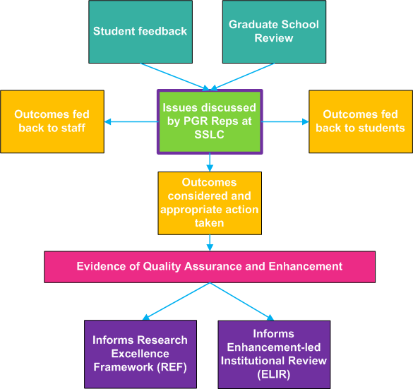
Where does my feedback go?

Slide 15
Student Representation Mechanisms and GUSRC
University Committees,
Sub-committees and working groups
SRC executive
PGR Reps
Students
PG Convenors
Members of SRC Council
Members of SRC Council
College Committees
Graduate School Boards
Staff-Student Liaison Committees
Notes:
Here’s an attempt at a diagram. What I haven’t drawn in here are the vertical arrows – the communication between the different layers of decision making and representation. For example the class reps will communicate back and forth with the students they represent, and also back and forth with the school reps who represent them. Issues raised at SSLC level may work their way up to school or college level (and onwards from there if need be) and likewise issues that are discussed at school or college level committees may well be discussed in more detail at a more local level, at SSLCs

Slide 16
Examples of Success – from reps
Active involvement with my fellow peers in ensuring that their views were expressed at the meetings, a greater understanding of processes involved at University as well as an appreciation of all the people who are involved and greater self confidence.
PGR students' profiles published on university website.
Changed the way a couple of courses were run in terms of learning resources and teaching style.
GTA rate of pay was difficult to understand. A new policy has been proposed for the school as a result.
We (two reps) succeeded in getting some of the building facilities improved.

Slide 17
Short break

Slide 18
Student Voice
Access through MyGlasgow portal
Content is tailored to each individual student
Can see information about subject area, School, College and University
Contact details for reps at all levels
‘Issue Tracker’ – reps can mark issues Complete, In Progress or Closed
Discussion forum for sharing views on learning experience
See recent activity/updates at a glance in MyGlasgow
Discussion space for class reps

Slide 19
Student Voice demo
MyGlasgow

Slide 20
Gathering student opinion
Student Voice
Emails
Face to face chats
Other online spaces:
Facebook.
Twitter.
Virtual Learning Environments.
Surveys.
Post it notes in tutorials.
Comment boxes.
Use the PG Social Space!

Slide 21
Effective feedback
The A,B,C,D of Effective Feedback
Accurate
Balanced
Constructive
De-personalised
Effective

Slide 22
Exercise 3 Gathering student opinion
Task
Look back to Exercise 1 and pick one of the elements you think could be improved.
Think how you would find out whether or not your fellow students agree.

Slide 23
Exercise 4 Developing solutions
Task
Taking the element you have singled out for improvement in Exercise 3, we want you to develop a solution to the problem.
You need to think about:
What resources the staff have access to.
How realistic your solution is.
How creative your solution is.
The ABCD of effective feedback
Notes:
23

Slide 24
Exercise 5 Getting your problem fixed
Task
There are no meetings for the next four months.
How are you going to try and get the staff to take on your solution to the identified problem?

Slide 25
Exercise 6 Getting your problem fixed - Negotiating
Task
You have suggested a solution to the issue identified in exercise 3. However, the staff you have spoken to so far don’t seem so keen.
How will you negotiate towards your preferred solution?
What might the barriers to implementing your solution be?
What compromises might you need to consider?
What is your ‘bottom line’ negotiating position?

Slide 26
Closing the feedback loop
Students give constructive feedback
Changes are made in response to feedback
Changes are communicated to the students (e.g. via student voice/PGR rep)
Students see the benefits of giving feedback. Students feel their opinions are valued and useful.
Students are more likely to give feedback in future
Notes:
I’ve been speaking about communication and how it goes both ways in that pyramid on the last slide – or at least it should do. You may be familiar with the feeling that issues are raised at SSLCs but nothing is done – or at least you never find out if anything will be done. This slide is a little illustration of the importance of closing the feedback loop. We start (hopefully) with students giving constructive feedback, and changes being made in response to this (ideal scenario, I know!). At the bottom of the wheel here we have the really important bit – the closing of the feedback loop, and this has beneficial effects as we can see here.

Slide 27
Closing the loop
Student Voice
Other online spaces:
Facebook.
Twitter.
Virtual Learning Environments.
Emails.
Face to face chats.
Use the PG Social Space!

Slide 28
Resources and Contact Information
SRC Website:
www.glasgowstudent.net/about/representation/class-reps
Student Voice
www.gla.ac.uk/students/myglasgow
Senate Office Website:
www.gla.ac.uk/services/senateoffice/qea/studentengagement/studentrepresentationstudentvoice/
Vice President (Education) – Kate Powell:
vp-education@src.gla.ac.uk
Notes:
Resources and Contact information
There are a number of sources you can use for further information and support:
SRC Student Representative Handbook
Code of Practice on Student Representation
Obtaining and Responding to Feedback from Students
Job Description for Student Representatives
You can find all of the above sources from www.glasgowstudent.net/studentreps and www.gla.ac.uk/services/senateoffice/qae/studentrepresentation/

Slide 29
Thank you for attending Introductory Level PGR Rep Training! Please fill in your evaluation forms and hand them in.
name of trainer
associate trainer | GUSRC

